Slide 1

CSA6502 – GENERATIVE AI AND LARGE SCALE MODEL
MS1 Jul-Sep 2026 - SLOT A
Project GenTwin: An Generative Digital Twin for Supply Chain Disruption Simulation and Resilience Planning
Presented by, 192472034 – C. Praveen Kumar
192472027 – N. Sunil Kumar
192472332 – C. Chandu
Guided by, Dr. Nithisha J

Slide 2
Abstract
Supply chain disruptions caused by natural disasters, transportation delays, supplier failures, and sudden demand fluctuations can significantly impact business operations. This project proposes a Generative Digital Twin for Supply Chain Disruption Simulation and Resilience Planning, which combines Digital Twin technology with Generative AI to create a virtual model of the supply chain and simulate realistic disruption scenarios. The system analyzes the impact of these disruptions on inventory, logistics, and delivery performance while assessing potential risks. Based on the simulation results, it recommends optimal recovery strategies such as alternative suppliers, transportation routes, and inventory adjustments. By enabling proactive planning and informed decision-making, the proposed solution enhances supply chain resilience, minimizes operational risks, and improves business continuity in dynamic environments.

Slide 3
Introduction
Supply chains are essential for transporting products from suppliers to customers, but they are vulnerable to unexpected disruptions.
Digital Twin technology creates a virtual representation of the supply chain, allowing organizations to monitor and simulate operations in a risk-free environment.
Generative AI can generate realistic disruption scenarios, such as supplier failures, transportation delays, and sudden demand changes, for effective planning.
The project combines Digital Twin and Generative AI to simulate disruptions and analyze their impact on inventory, logistics, and delivery performance.
Based on the simulation results, the system provides resilience planning by recommending alternative suppliers, routes, and recovery strategies.
This approach helps organizations improve decision-making, reduce operational risks, and ensure business continuity through proactive supply chain management.

Slide 4
Literature Survey
Author(s), Year, Journal/Proceedings | Title | Key Findings
P. Bhambri & H. Sharma (2026), Next-Gen Supply Chains (Wiley) | Generative AI's Impact on Supply Chain Decision-Making | Demonstrated that Generative AI enhances supply chain decision-making through scenario generation, predictive analytics, and digital twin integration.
Latifa Benhamou, Vincent Giard & Samir Lamouri (2026), International Journal of Production Economics | Digital Twins in Supply Chain Management: Scope and Methodological Issues | Highlighted the role of Digital Twins in real-time monitoring, disruption prediction, and adaptive supply chain management while identifying current implementation challenges.
Dmitry Ivanov (2026), International Journal of Production Research | Agentic Digital Twins: Bridging Model-Based and AI-Driven Decision-Making Support | Proposed AI-powered digital twins that combine simulation with intelligent decision support for resilient and autonomous supply chain operations.
Tho V. Le & Ruoling Fan (2023), arXiv | Digital Twins for Logistics and Supply Chain Systems: Literature Review, Conceptual Framework, Research Potential, and Practical Challenges | Presented a comprehensive framework for applying digital twins in logistics, emphasizing improved visibility, resilience, and operational efficiency..
Keqi Wang et al. (2020), arXiv | Simulation-Based Digital Twin Development for Blockchain Enabled End-to-End Industrial Hemp Supply Chain Risk Management | Developed a simulation-based digital twin integrated with blockchain to improve supply chain transparency, risk management, and decision-making.

Slide 5
Research Gaps
Existing studies provide limited integration of Generative AI with Digital Twin models for intelligent disruption simulation.
Most Digital Twin systems focus on monitoring and simulation rather than automated resilience planning and decision support.
Current research lacks simulation of multiple simultaneous supply chain disruptions and their combined impact.
Many proposed frameworks remain conceptual with limited validation in practical supply chain environments.
Existing approaches provide limited optimization of recovery strategies, including alternative suppliers, routes, and inventory planning.

Slide 6
Problem Statement
Existing Digital Twin solutions primarily focus on monitoring and visualization but provide limited support for AI-driven disruption prediction and recovery planning.
Most current studies simulate individual supply chain disruptions, while real-world scenarios often involve multiple simultaneous disruptions that significantly affect resilience.
There is a need for an integrated framework that combines Generative AI with Digital Twin technology to generate realistic disruption scenarios, evaluate their impact, and recommend optimal resilience strategies for effective decision-making.

Slide 7
Objectives
To develop a Digital Twin model that accurately represents the supply chain network and its operational components.
To utilize Generative AI for creating realistic supply chain disruption scenarios and simulating their potential impacts.
To analyze disruption effects on inventory, transportation, cost, and delivery performance for effective risk assessment.
To recommend optimal resilience strategies, including alternative suppliers, routes, and inventory plans, to improve business continuity and decision-making.

Slide 8
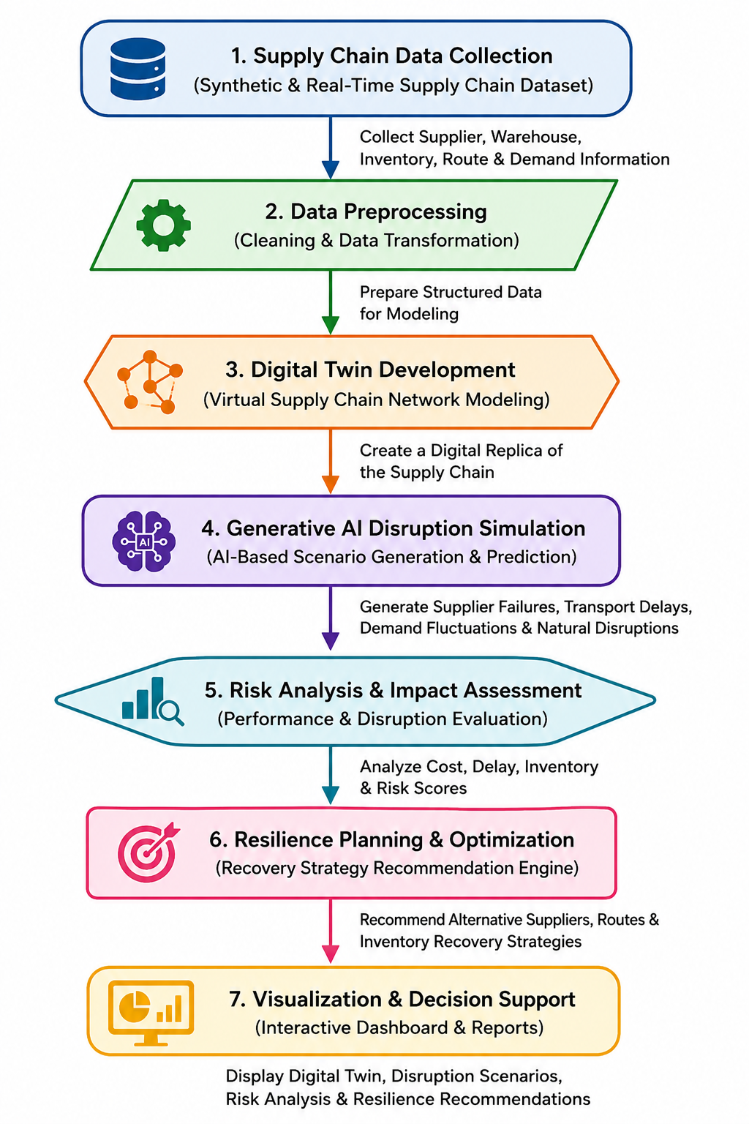
Methodology
Collect supply chain data such as suppliers, warehouses, inventory, routes, and customer demand.
Clean and organize the data before using it in the system.
Create a virtual model (Digital Twin) of the supply chain.
Use Generative AI to create different supply chain disruption scenarios.
Analyze how these disruptions affect cost, inventory, and delivery.
Suggest the best recovery plans, such as alternative suppliers and routes.
Display the results using dashboards, charts, and reports.

Slide 9
Module-1: Supply Chain Digital Twin Development
Collect supply chain data such as suppliers, warehouses, inventory, transportation routes, and customer demand.
Clean and organize the collected data to ensure accuracy and consistency.
Create a virtual Digital Twin that represents the real-world supply chain network.
Connect all supply chain components to visualize the flow of products and information.
Monitor the current status of inventory, transportation, and warehouse operations within the Digital Twin.
Prepare the Digital Twin model for disruption simulation in the next module.

Slide 10
Module-2: Generative AI – Based Disruption Simulation
Generate realistic supply chain disruption scenarios using Generative AI.
Simulate events such as supplier failures, transportation delays, and demand fluctuations.
Analyze how each disruption affects different parts of the supply chain.
Estimate the impact on inventory, delivery time, and operational cost.
Identify critical risks and assign a risk score to each disruption.
Pass the simulation results to the resilience planning module.

Slide 11
Module-3: Resilience Planning and Decision Support
Analyze the disruption results to identify the best recovery options.
Recommend alternative suppliers, transportation routes, and inventory plans.
Optimize recovery strategies to reduce delays and operational costs.
Estimate the recovery time and overall supply chain resilience.
Display recommendations through interactive dashboards and reports.
Support decision-makers in maintaining business continuity during disruptions.

Slide 12
Algorithm, Tools & Technologies Used
Algorithms/Techniques used:
Algorithm/Technique | Purpose
Digital Twin Modeling | Creates a virtual representation of the supply chain.
Large Language Model(LLM) | Generates realistic supply chain disruption scenarios.
Risk Assessment | Evaluates the impact and severity of disruptions.
Dijkstra’s Algorithm | Finds the best alternative transportation routes.
Optimization Technique | Recommends optimal recovery and resilience strategies.

Slide 13
Algorithm, Tools & Technologies Used
Tools & Technologies:
Tool / Technology | Purpose
Python | Backend development and Implementation
Streamlit | Interactive web application development
SQLite | Database management
Pandas & NumPy | Data preprocessing and analysis
NetworkX | Digital Twin and supply chain network modeling
Gemini API | AI-based disruption scenario generation
Plotly / Matplotlib | Data visualization and dashboards

Slide 14
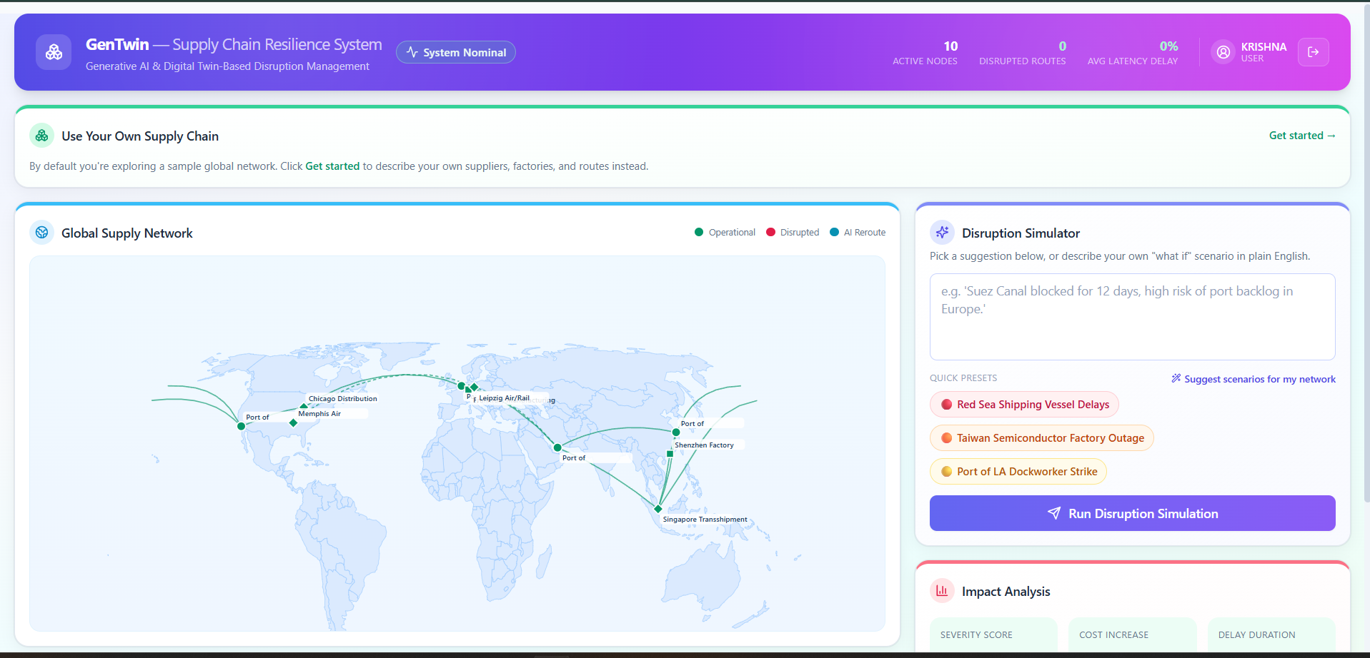
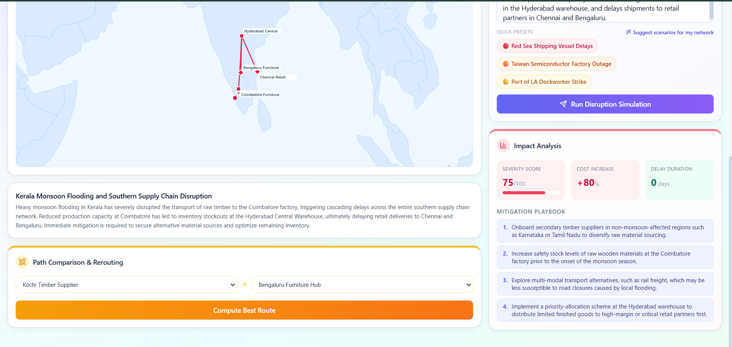
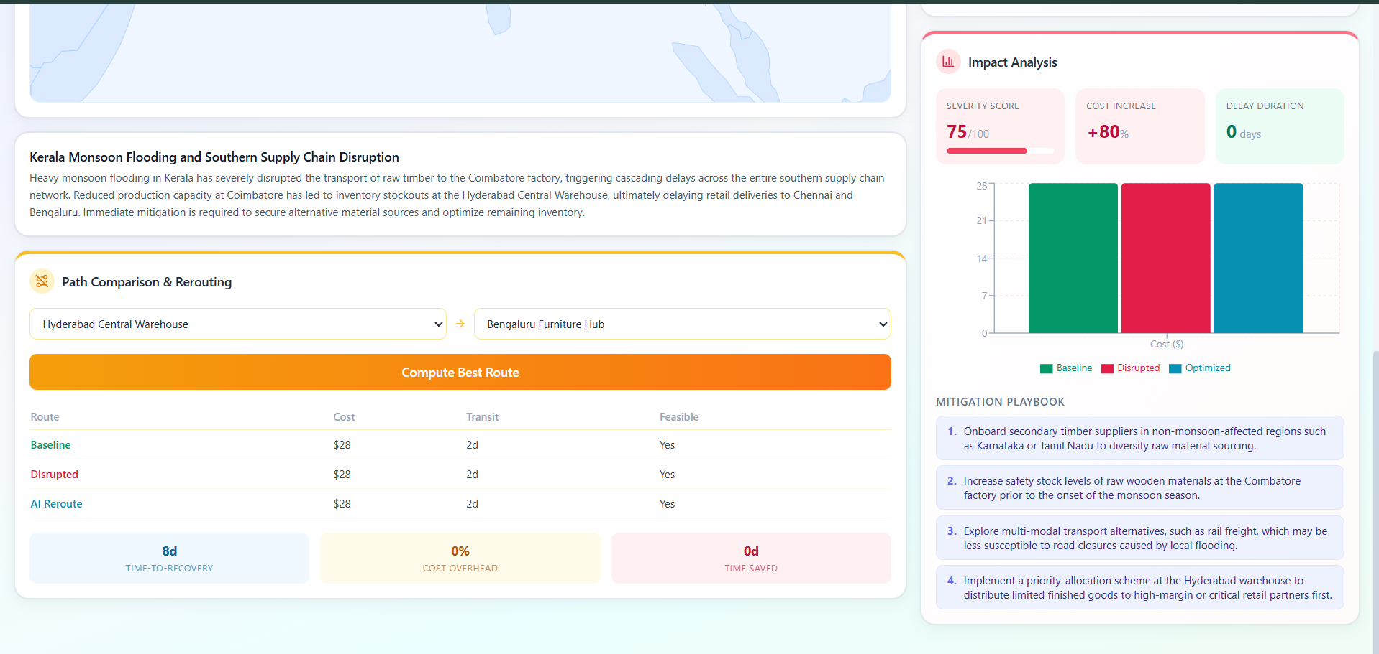
Results(Screen shots)
Figure 1: Streamlit dashboard — Digital Twin network view
Figure 2: Streamlit dashboard — disruption simulation results and estimated impact.
Figure 3: Streamlit dashboard — resilience planning recommendations.

Slide 15
Conclusion
The GenTwin project successfully integrates digital twin technology and generative AI to revolutionize supply chain management through advanced disruption simulation and resilience planning. By creating a robust virtual network using Python, NetworkX, and SQLite, the system models real-world inventory, logistics, and customer demand flows. Leveraging the Gemini API, it simulates complex, multi-faceted disruption scenarios such as supplier failures and transit delays while assessing critical operational risks. Furthermore, the framework incorporates Dijkstra's algorithm and intelligent optimization techniques to automatically generate optimal recovery strategies, like alternative routing and backup supplier selection. Stakeholders can effortlessly interact with these insights through a dynamic Streamlit-backed dashboard that displays real-time reports and visual analytics. Ultimately, this proactive decision-support tool empowers organizations to minimize operational downtime, reduce financial costs, and ensure long-term business continuity in highly volatile environments. This innovative approach bridges the gap between passive monitoring and autonomous, risk-resilient supply chain operations.

Slide 16
References
Benhamou, L., Giard, V., & Lamouri, S. (2026). Digital Twins in Supply Chain Management: Scope and Methodological Issues. International Journal of Production Economics.
Ivanov, D. (2026). Agentic Digital Twins: Bridging Model-Based and AI-Driven Decision-Making Support. International Journal of Production Research.
Abdel Hakim Azzi & Karim Gacem (2026). A Bibliometric Analysis of Digital Twin Applications in Supply Chain Management: Evidence from Scopus (2015–2025).
Osei, E., et al. (2024). Supply Chain 4.0 and the Digital Twin Approach: A Framework for Improving Supply Chain Visibility. Procedia CIRP.
Le, T. V., & Fan, R. (2023). Digital Twins for Logistics and Supply Chain Systems: Literature Review, Conceptual Framework, Research Potential, and Practical Challenges. arXiv.
Wang, K., et al. (2020). Simulation-Based Digital Twin Development for Blockchain Enabled End-to-End Industrial Hemp Supply Chain Risk Management. arXiv.

Slide 17
Thank You
Happy to Take Your Questions

